Slide 1
Business Modelling Assignment 2
Oisín Coburn, Gareth Mc Donnell, Abdulrahman Al Ghamdi

Slide 2


Slide 3
Introduction
When our group first met up, we ran through each assignment and decided that a good project to choose would be the assignment based on Rockall Technologies as this focused on a technology company which uses the Agile and Scrum methodology and seemed like an appropriate choice for this module.
Our Project Manager/Scrum Master/Product Owner is Oisín Coburn as this project is based on his assignment and therefore he would be responsible for answering any questions or clarifying anything which may appear as unclear to any team members. Oisin also contributed greatly to dealing with the sprint backlog, the product backlog and the burn-down chart. He was also responsible for the use-case diagram
The second member was Abdulrahman Al Ghamdi who was responsible for Product Implementation team issue fixing process and the diagrams involved with them.

Slide 4
Introduction(continued)
The third member was Gareth McDonnell. He was responsible for the Client Issue Resolving Process and the diagrams involving that topic and with the business case diagrams.
The rest of the work was done as a team together.
Another factor why we decided on this project instead of our other options is that we felt it would be a good idea to focus on a technology company as it seemed as the most relevant choice in terms of the course we are studying. Also it is important to note that Rockall Technologies previously implemented the waterfall methodology and it is only in the last year that they have moved to Agile. We felt that when focusing on process improvements, it would be good experience to see what could be improved from a company which have recently made the switch to Agile and are ongoing in changing their business processes in order to become more Agile.

Slide 5
Rockall Technologies Overview
Rockall Technologies is a Irish-based technology company which develops a collateral management web application which Bank employees worldwide use in order to record important information on client loans and assets associated with those loans.
In terms of their development Rockall is subdivided into two teams, the Product team and the Product Implementation team. The product team is responsible for developing the standard product i.e. they focus on only the functionality of the product and ensuring it operates as it should. The Product Implementation team is responsible to customizing the product for each specific bank, this may consist of adding new asset types which banks may require or even just adding a few new text fields on a page so certain banks can record information which only they require.

Slide 6
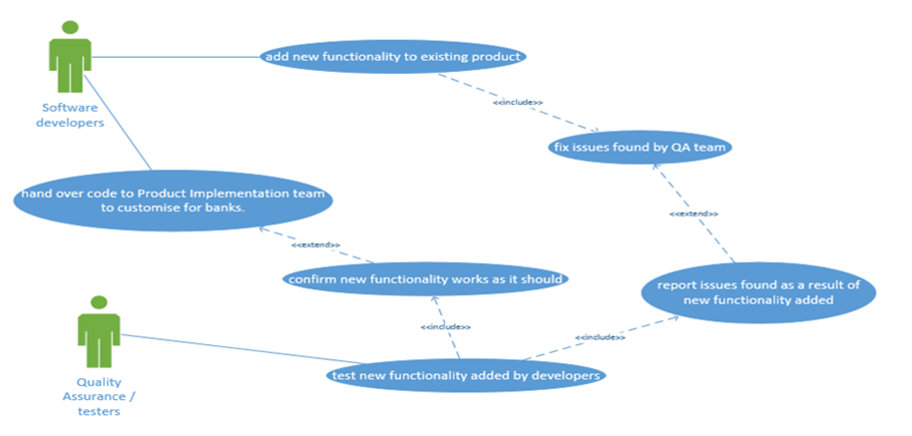
Before the product team hand over their code for the Product Implementation team
they ensure it functions as it should as follows:

Slide 7
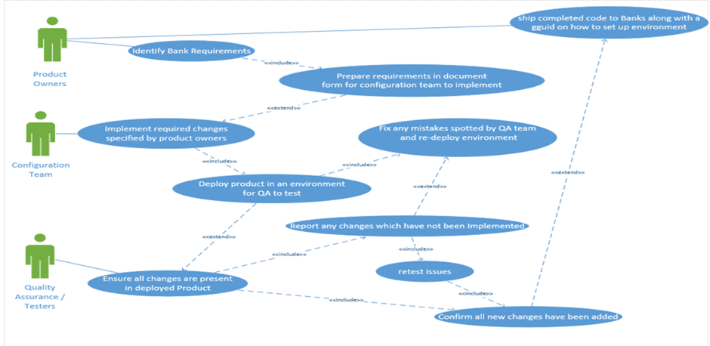
Once the Product Implementation team receives the code the Product Owners work alongside clients in order to identify
their specific requirements and clarify these requirements for the Configuration sub-team to implement and QA staff to test
as follows:

Slide 8
Our suggested process Improvements are as follows:
Quality Assurance testing process.
Product Implementation team issue fixing process
Client issue resolving process.

Slide 9
Quality Assurance testing process.
Current Process: In the above diagrams we can see that once new functionality is added to the product, the Product QA team begins testing it to ensure it works. Once this is done, the Product team will then hand over their code to the Product Implementation Team who will begin to customize the product to the clients requirements. There is also a Product Implementation QA team which checks if all of the clients requirements have been implemented.
Suggested Process: Our suggested process improvement would be that the two QA teams should merge together and that all testing should take place after the Configuration team has customized the product to meet client requirements. This way the Configuration team(who implement the changes) will not have to wait for the QA team to finish testing new functionality before they can work on customization and also the new larger QA team will focus on testing new functionality and ensuring the requested client changes are present after all changes to the product has taken place.

Slide 10
In Order to implement this new process:
Both QA teams will merge and their online profiles will have to be updated in order to have access to view and update user stories on both Sprint backlogs.
The Product team and the Product Implementation will have to hold planning sessions co-ordinate their sprints so both the new product functionality have been added and client changes have been implemented in order to deploy code together for the new larger QA team to implement. This will involve meetings between the Product Owners and the Product team leaders.

Slide 11
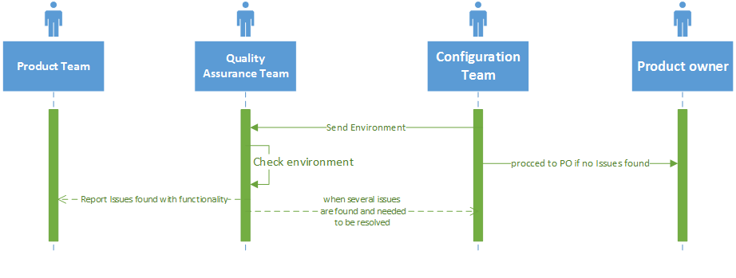
Sequence diagram for Quality Assurance testing process.

Slide 12
Product Implementation team issue fixing process
Current Process: In the current process improvement, a product is made by the configuration team, the configuration team send it to the Quality Assurance Team and then they check it and report it to the configuration team if the product has any issues then the configuration team will fix the founded issue and upgrade their environment and send the upgraded version to the Quality Assurance Team again to test it and see if the product is perfectly made and ready to be sent to the product owner.
Suggested Process: in the suggested process improvement, the configuration team deploy the environment then they will send to the Quality Assurance Team and then if they find any issues with the customization then the Quality Assurance Team will take notes of those mistakes and then report them when several issues have been found to the configuration team. Therefore, the Quality Assurance Team sends the product to the configuration team to resolve the existing issue and re-deploy the environment, then they will send it back to the Quality Assurance Team to check it all and see if there is any issues still exist, then the Quality Assurance Team will send it to the tester.

Slide 13
Product Implementation team issue fixing process (continued)
At this stage, the configuration team will receive the issues from the tester directly and the resolve the issues and redeploy the environment then the process will repeated as above where the configuration team will send the product to the Quality Assurance Team to recheck them all and to also see if the issues still exists, as in Bulk, Fixing and restarting issues will save the configuration a lot of time and make the process go easier.
Another suggestion in relation to this process improvement would be that the configuration team should be able to send a quick email around the developers on the product team 30 minute before deploying the product, to find out whether there are any new issue fixes to be included in the deployment.

Slide 14
In Order to implement this new process:
Ensure all QA testers know how to flag issues to retest them for the next deployment.
Create a mailing list consisting of all software developers on the product team and configuration members on the Product Implementation team to give notice of re-deployments in order to fit in all last minute bug fixes

Slide 15
Sequence diagram for Quality Assurance testing process.

Slide 16
Product Implementation team issue fixing process
Current Process: In the current process improvement, a product is made by the configuration team, the configuration team send it to the Quality Assurance Team and then they check it and report it to the configuration team if the product has any issues then the configuration team will fix the founded issue and upgrade their environment and send the upgraded version to the Quality Assurance Team again to test it and see if the product is perfectly made and ready to be sent to the product owner.

Slide 17
Product Implementation team issue fixing process(continued)
Suggested Process:
In the suggested process improvement, the configuration team deploy the environment then they will send to the Quality Assurance Team and then if they find any issues with the customisation then the Quality Assurance Team will take notes of those mistakes and then report them when several issues have been found to the configuration team. Therefore, the Quality Assurance Team sends the product to the configuration team to resolve the existing issue and re-deploy the environment, then they will send it back to the Quality Assurance Team to check it all and see if there is any issues still exist, then the Quality Assurance Team will send it to the tester.
At this stage, the configuration team will receive the issues from the tester directly and the resolve the issues and redeploy the environment then the process will repeated as above where the configuration team will send the product to the Quality Assurance Team to recheck them all and to also see if the issues still exists, as in Bulk, Fixing and restarting issues will save the configuration a lot of time and make the process go easier.

Slide 18
Product Implementation team issue fixing process(continued)
Another suggestion in relation to this process improvement would be that the configuration team should be able to send a quick email around the developers on the product team 30 minute before deploying the product, to find out whether there are any new issue fixes to be included in the deployment.

Slide 19
In Order to implement this new process:
Ensure all QA testers know how to flag issues to retest them for the next deployment.
Create a mailing list consisting of all software developers on the product team and configuration members on the Product Implementation team to give notice of re-deployments in order to fit in all last minute bug fixes.

Slide 20
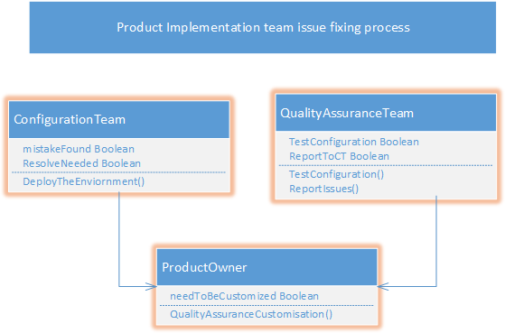
Class Diagram for Product Implementation team issue fixing process.

Slide 21
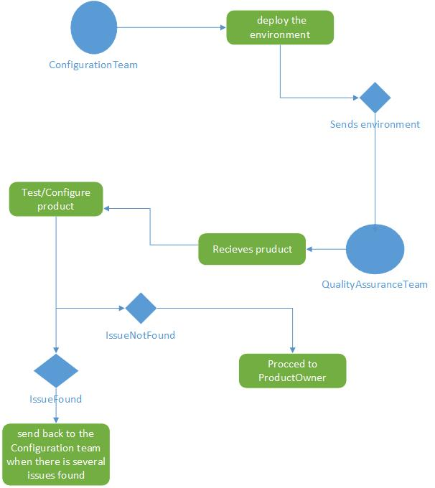
Activity Diagram for Product Implementation team issue fixing process.

Slide 22
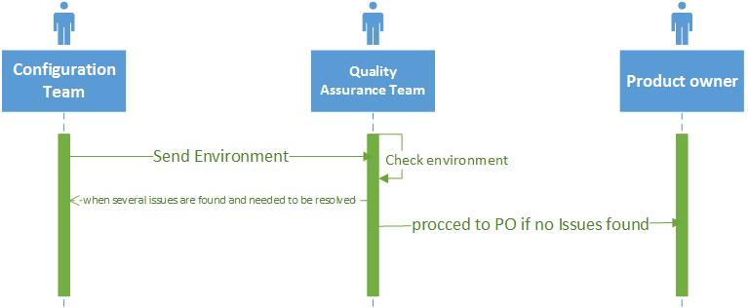
Sequence Diagram for Product Implementation team issue fixing process.

Slide 23
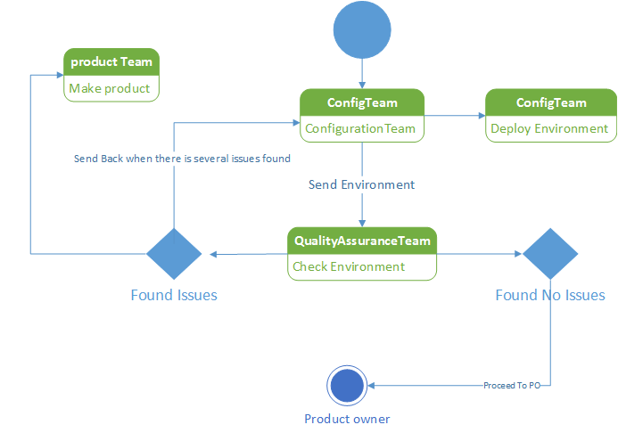
State Diagram for Product Implementation team issue fixing process.

Slide 24
Client Issue Resolving Process
Rockall could implement a new software system by creating videos which offer a step by step guide to clients which will aid them in implementing the product without problems. Previously there had been problems, such as clients misunderstanding and misusing the product.
To do this, Rockall will need screen recording software. This software can be downloaded online free of charge online for example here.
It is critical that the client would be able to use the product correctly, so that the information they keep on their customers is right or else this will lead to problems down the road.
Rockall will assign the technical writer from within their company to create the application, this will also keep costs down as they are not hiring new employees for the task

Slide 25
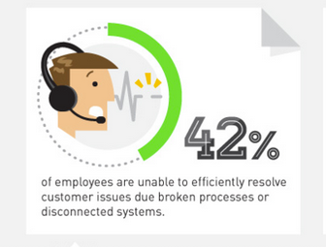

Slide 26
In Order to implement this new process
The alternatives of which screen recording software must be evaluated and decided upon.
The Rockall Technologies technical writer (this is the person who looks a lot of the documentation for clients) will have to be trained in order to use the chosen video recording software.
Videos will have to be made in order to demo the existing software functionality on the product to date. These videos will not be needed for all functionality on the system currently, only the more complex functionality.

Slide 27
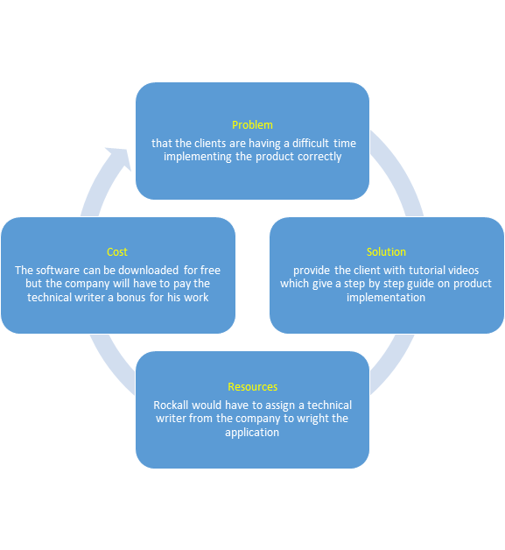
Case diagram

Slide 28
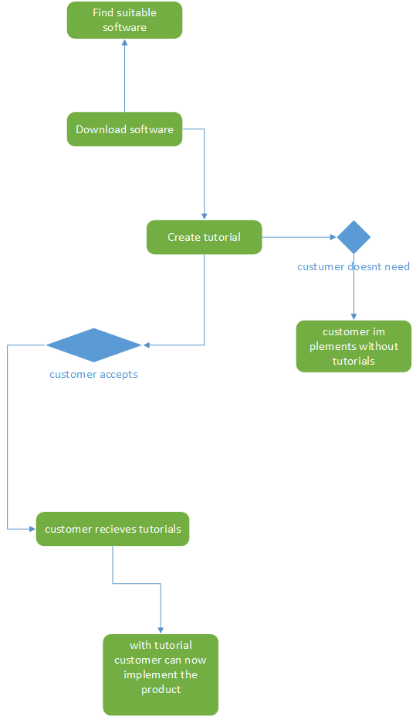
Activity diagram for Client Issue Resolving Process

Slide 29
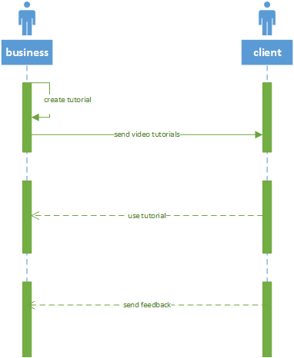
Sequence diagram for client issue resolving process

Slide 30
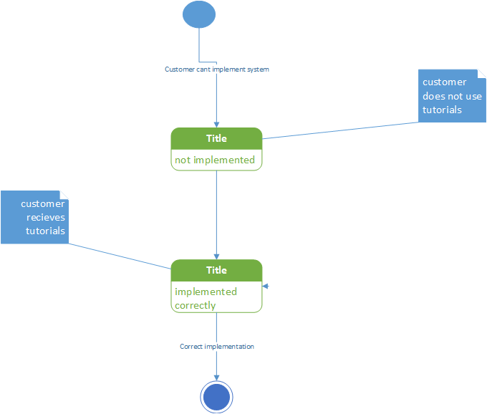
State diagram for client issue resolving process

Slide 31
The user stories required to implement the changes required in order for the above process improvements can be found below:
Product Backlog
Estimation (DAYS) | Description
.5 | Update profiles for members of both QA teams in order to allow them to view user stories for both the Product team and the Product Implementation team.
.2 | Session with the Product Team Leaders and Product Owners in order to decide how to coordinate both sprints in order to combine both QA teams
1 | The alternatives of which screen recording software must be evaluated and decided upon.
1.5 | The Rockall Technologies technical writer (this is the person who looks a lot of the documentation for clients) will have to be trained in order to use the chosen video recording software.
8 | Videos will have to be made in order to demo the existing software functionality on the product to date. These videos will not be needed for all functionality on the system currently, only the more complex functionality.
.5 | Ensure all QA testers know how to flag issues to retest them for the next deployment.
.5 | Create a mailing list consisting of all software developers on the product team and configuration members on the Product Implementation team to give notice of re-deployments in order to fit in all last minute bug fixes.

Slide 32
Sprint 1 Backlog
Note: In order to ensure Rockall continues to develop and test their product we have allowed 15 days for development and 5 for testing in each sprint
Sprint 1
Estimation (days) | Description
.5 | Update profiles for members of both QA teams in order to allow them to view user stories for both the Product team and the Product Implementation team.
.25 | Session with the Product Team Leaders and Product Owners in order to decide how to coordinate both sprints in order to combine both QA teams
.5 | The alternatives of which screen recording software must be evaluated and decided upon.
1.5 | The Rockall Technologies technical writer (this is the person who looks a lot of the documentation for clients) will have to be trained in order to use the chosen video recording software.
15 | Ongoing Product Development
5 | Ongoing Product Testing

Slide 33
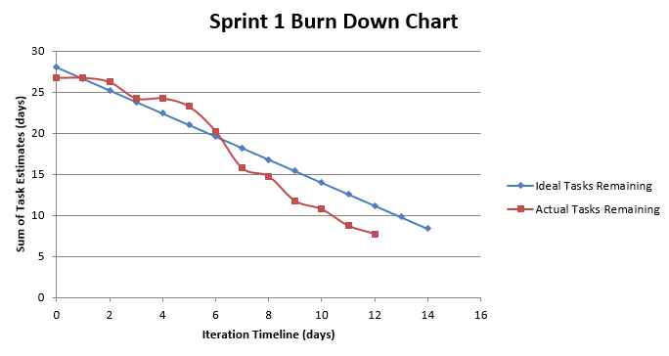

Slide 34
Sprint 2 Backlog
Sprint 2
Estimation (days) | Description
3.5 | Videos will have to be made in order to demo the existing software functionality on the product to date. These videos will not be needed for all functionality on the system currently, only the more complex functionality.
.25 | Ensure all QA testers know how to flag issues to retest them for the next deployment.
.75 | Create a mailing list consisting of all software developers on the product team and configuration members on the Product Implementation team to give notice of re-deployments in order to fit in all last minute bug fixes.
15 | Ongoing Product Development
5 | Ongoing Product Testing

Slide 35
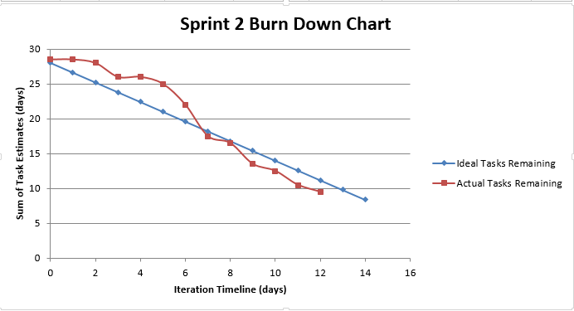

Slide 36
Conclusion
We expect that by then end of our two 2 week sprints mentioned in the above slide, Rockall technologies will have made significant process improvements involved in the development of their product.
Assuming all goals are reached and no obstacles are stopping the above process Improvements from being implemented the Rockall technologies development use case diagram will be as follows, as seen on the following slide.

Slide 37
